Slide 1
Talking to Humans
Alternative title: How to avoid sounding like a bot
Joanna Buczkowska-McCumber

Slide 2
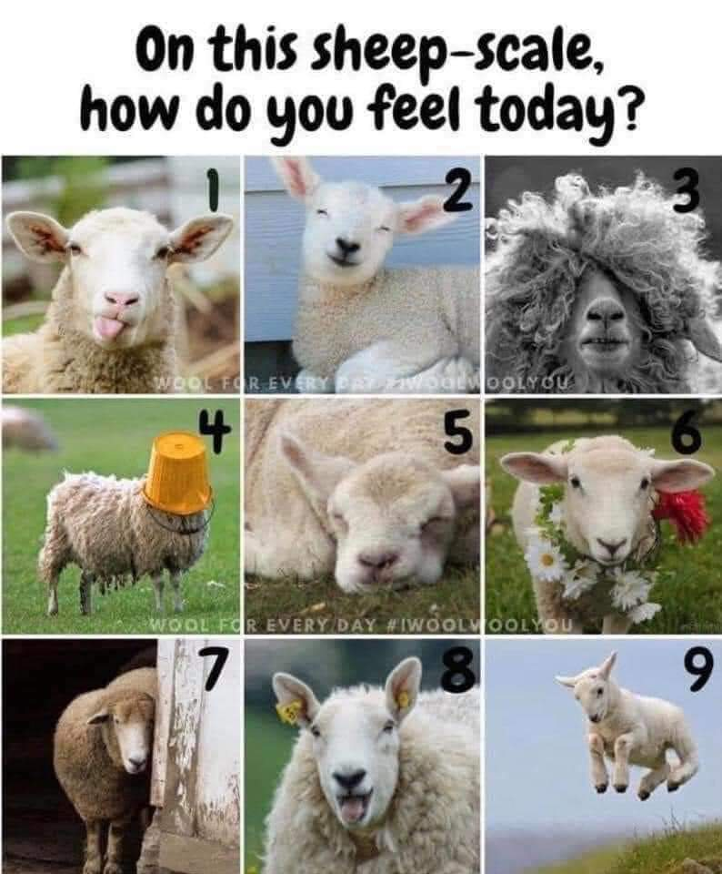

Slide 3
5 STEPS FOR SUCCESS
INTERVIEW TIPS
AGENDA
USING BOTS TO AVOID SOUNDING LIKE ONE
PRACTICAL EXERCISES
HOMEWORK

Slide 4
5 STEPS FOR SUCCESS
Notes:
Be human yourself
Find (ideal) other humans
Talk
Listen
Learn
And that dear students, is a communication high five!

Slide 5


Slide 6
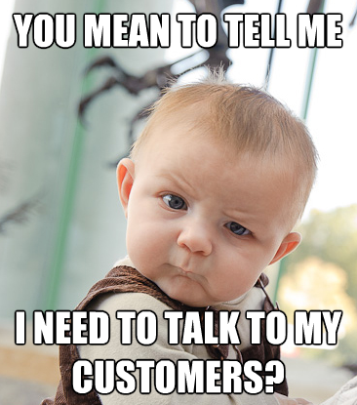

Slide 7
STEP 1: BE HUMAN
Be Real,
Be You
Know Yourself
Cultural Considerations
Notes:
Be real, be you
Know yourself
How do you like to communicate with others?
Where are you comfortable?
What do you need with you?
What do you have?
What can you practice or prepare for?
Cultural Considerations
Where in the world is your interviewee?
What are their expectations?
What cultural considerations should you be aware of?
Language
Formality
Ettiquette

Slide 8


STEP 2: FINDING THE
RIGHT PEOPLE
There’s no special map. There’s no single skill. But there are a SET of special skills! You have to get out of the lab, into the world around you, and actively reach out to people.
Notes:
Step 2 is finding the right peopleThere’s no special map. There’s no single skill. But there are a SET of special skills!
You have to get out of the lab, into the world around you, and actively reach out to people.
It can be scary. But you are brave. (Otherwise you wouldn't be here.)

Slide 9

When You Find The Right People
Notes:
Step 2 is finding the right peopleThere’s no special map. There’s no single skill. But there are a SET of special skills!
You have to get out of the lab, into the world around you, and actively reach out to people.
It can be scary. But you are brave. (Otherwise you wouldn't be here.)

Slide 10

STEP 2: FINDING THE RIGHT PEOPLE
HOW?!? Customer Discovery!
100 interviews empowers you to:
(In)validate the problem/solution fit
(In)validate the business model
Begin to identify + test your hypothesis
We’re on the hunt for patterns, perspectives, and that wonderful problem/solution fit!

Slide 11
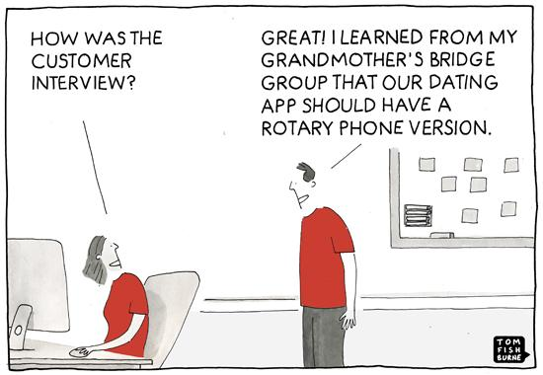
CHOOSING HUMANS

Slide 12

CHOOSING HUMANS
First, let’s admit we don’t know what we don’t know. Sometimes the process of elimination can be easier to start with than getting it perfect on the first try.
Who do you want to speak to?
How will you know they’re “right”?
Notes:
Who do you want to speak to?
Who is wrong?
Who is irrelevant?
Who is a leading voice in the industry?
Who is using something similar now?
How will you know?
Are they in your lab? Wrong.
Are they in your family? Irrelevant.
Did your mentor recommend them? Start there!

Slide 13
WORK SMARTER
You don’t know everyone. You don’t even know most people. So, it’s time to get comfortable being a bit uncomfortable and getting to know strangers.
Explore LinkedIn (slowly and steadily)
Ask for referrals
Check out industry groups for membership directories
Check out industry conferences for speakers and sponsors
Check out industry publications
Check out your alumni association

Slide 14
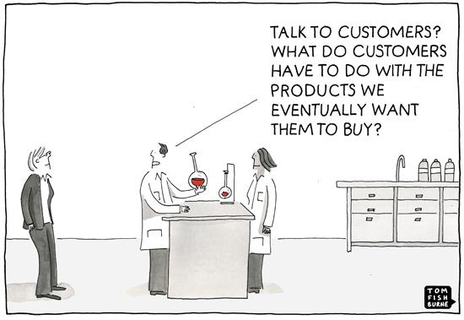
TIME TO TALK

Slide 15

STEP 3: TALKING TO HUMANS
Talk is the key word here!
Is an email with a list of questions a conversation? No.
Is listing a series of questions without a breath between at someone a conversation? No.
You want to speak with people so that you can follow interesting threads and their logic — not just your script.

Slide 16

STEP 4: STOP TALKING
TWIST! Step four is all about LISTENING!
The whole secret to talking to people and doing customer discovery is really LISTENING.
In a good interview, you’ll do very little talking. Instead, you’ll do a lot of listening, asking follow up questions, and writing things down.

Slide 17

STEP 5: LEARN
Notes:
Take what you wrote and implement it.
Repeat the process with each interview.
What changes in your outreach?
What changes in your conversation guide?
Who else can you practice on?
What feedback is your mentor giving?
What about classmates and facilitators?
We grow when we’re willing to adapt.

Slide 18

STEP 5: LEARN
Put on your analytical hats! We’re reviewing the conversation.
What worked really well?
What didn’t work so great?
What did you forget to ask?
What’s one thing you’d try differently next time?
What’s one thing that you want to absolutely keep the same?
WRITE. IT. DOWN.
Notes:
Take what you wrote and implement it.
Repeat the process with each interview.
What changes in your outreach?
What changes in your conversation guide?
Who else can you practice on?
What feedback is your mentor giving?
What about classmates and facilitators?
We grow when we’re willing to adapt.

Slide 19

QUESTIONS?

Slide 20
INTERVIEW TIPS
Notes:
Ok, great recap! Glad to see these concepts are sticking ☺ Now let’s talk talking and how you can take all this knowledge, early insight, and good hypotheses and turn these pieces into something wonderful—a powerful story and a compelling pitch.
First step in all communication: know your audience!

Slide 21
INTERVIEW TIPS
Start at the start
Build a strategy
Different is good
Notes:
Start at the start
Use your network—a warm introduction is ideal
Cold call/email—it’s hard, it’s time consuming, it’s full of disappointment, and IT WORKS
Do your research
Build a strategy
Set a daily schedule for yourself
Build your contact list, work the list!
Follow up (3+ times may be necessary!)
This is why you have a CRM
Different is good
Call people
BEFRIEND THE RECEPTION TEAM + EXECUTIVE ASSISTANTS. They are the calendar keepers.
Email people – be kind to everyone
LinkedIn message people (last choice)

Slide 22
LET’S TEST THIS OUT!
Build the structure for an outreach strategy:
Goal: 15 completed interviews every week.
Challenge: Getting that done every week, AND uploaded to AirTable
Strategic Considerations:
How many invites for interviews will you need to send out?
How are you going to schedule + manage those?
How are you going to know what to adapt or revise?
How are you going to work through a challenge?
How are you going to celebrate an achievement?

Slide 23
QUESTIONS?

Slide 24
AI (+ LLMs) IS YOUR FRIEND
Notes:
Writing an email or a voice mail script from nothing is a dauting task for anyone – including half the time professional communicators. So if you’re coming into this and English is your second language, or you’re planning to do a lot of international outreach, having the best tools at hand can make the process more creatively rewarding and dial down the stress.
In short, you can exchange the stress of what do I say for the stress of is that the best way to say it? And yes, one of those is better than the other!
So let’s talk ChatGPT

Slide 25


Slide 26
Leveraging AI + LLMs
You can absolutely use ChatGPT (and others) to help you write your emails and messages. Get creative with prompts. Play with subject lines.
Leah’s Dire Warning: DO NOT use whatever an AI tool gives you as the final edition of your message. It’s not human, it’s not you. You need to be you in the email—it’s the first impression you get to make. Make it real, make it you.
So, you take the AI output and treat it as a first draft. Then you make revisions. Then you can send it.

Slide 27
PITCHING THE INTERVIEW
Pitching a great ask
Be short and sweet in your message. Put the ask up front/up top.
You’re on their time—you meet when they can.
Be clear that you’re not selling anything (because you ARE NOT SELLING ANYTHING!)
Be on time. This is not long. 15-20 minutes is awesome.
If you were referred, let them know!

Slide 28
What Goes in The Email?
Subject Line: Succinct specificity is the goal
Email Components:
Greeting
Introduction
Ask
Value Demonstration
Scheduling
Sign off
Notes:
How to write a good subject line? Consider the filters, choose your words wisely. Interview vs chat; perspective vs insights; understanding vs data collection
Greetings: what is the context of your recipient? Canadian business customs are different from Japanese which are different from Brazilian. Do some research before you reach out. “Hello” is safe. “Greetings!” is spam.
Introduction: You’ve got 1-2 lines to tell me who you are and establish that you’re worth my time reading this. Be brief, leverage L2M, tailor your intro to each person’s context.
Ask: GET TO THE POINT! Chat, 20 minutes, get their experience and perspective on Topic, want to learn how this tech/tool/process is being worked in the real world and the creative ways it’s being employed.
Demonstrate the value of talking to you: It’s obvious why there’s value to you in this chat. What’s the value to them? You need to tell them why you’re worth the time.
Scheduling: you are flexible, suggest some days/times and be open to alternatives.
Sign off: stick the landing. Thank them for considering this ask. Welcome a referral if there’s someone else they feel is more appropriate to speak with. Promise to follow up.

Slide 29
QUESTIONS?

Slide 30
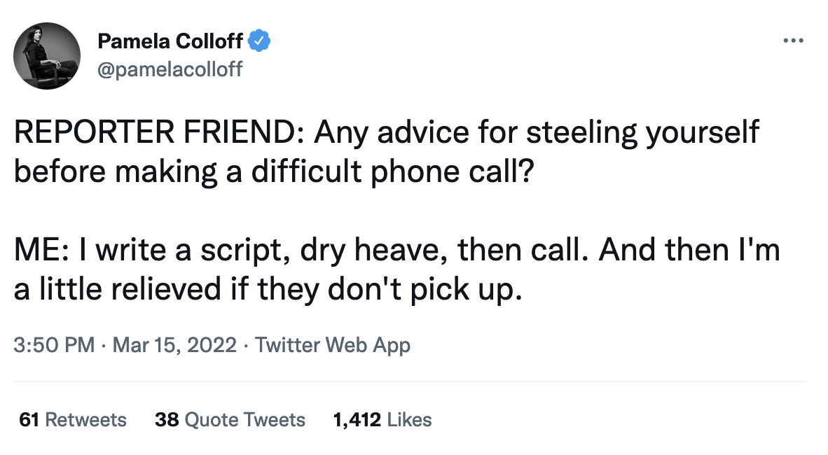
EVERYONE IS UNCOMFORTABLE
Notes:
This isn’t a natural thing you do every day. The first outreach efforts are going to be rough. It’s like learning to play an instrument, pick up a language, or ride a bike. It sounds bad but you’re trying! The accent is rough, but your praciting. It physically hurts, but you get back up when you fall.
In today’s working world, AI is part of just about everything, so take advantage of the tools you have and use them as co-pilots on your communication journey.
The rules are simple:
- Don’t give it any confidential information, including about your tech specifics
- Treat everything it gives you as a first draft that you, a human, will build off of in order to communicate with other humans
- Play around with your prompts – prompt design makes a world of difference in the output. Instead of instructing your tool, encourage it and motivate it, remind it that is is a marketing or communications expert and this is an important task. You’ll get better results!

Slide 31
BUT WHAT DO YOU ACTUALLY SAY?!
Start with a basic structure—what do you want to learn from this person, and why them? Write that down.
Decide how you’re going to reach out. Write that down.
Write a script. Practice it.
Take it for a spin in the real world. Write down what doesn’t work. Note what does. Adapt the script. Try again.

Slide 32
Cold Calls and Voice Mail
Structure: Greeting, Your Name, Ask/Value, Intro details, Sign Off
Example:
Hello (their Name), This is (Your Name). I’m calling to see if you’d be available for a short chat this week or early next. I’m a University of X student currently in the Canadian Lab2Market program and I’m exploring how X is used in your line of work. As the Y of your org, I thought you might have some interesting experiences you might be open to sharing with me. If you’re open to a 20 minute chat, I’d really appreciate it. You can reach me at (Phone number) or (email). And I’ll follow up in a few days too. Thanks so much!
Notes:
And for voice mails, it’s the email, but shorter and spoken.

Slide 33
THE GOAL IS TO LEARN
Step 5 in Talking to Humans is the big one: Learn. You were you, found and chose humans to talk to wisely, talked to them, listened closely, and now you put that learning together.
You are not interviewing to sell a product
You are not interviewing to pitch a concept
You are not interviewing for a job
Notes:
You are trying to learn about a market you may have a product or service for. The first step is learning all you can about the market—so you can work in it effectively.
That’s why we interview. To learn.
To learn about the customers, the market, the market we want to be a part of. We learn so we can succeed.

Slide 34
EXERCISE TIME!

Slide 35

The Challenge
Write a draft voice mail script centered on getting an interview to learn more from industry professionals.
Timer is set, individual work, cameras on.
Pop any questions in the chat!

Slide 36
The Challenge
Ok, turning up the heat on these challenges! Now you’re going into breakout rooms to test the scripts on other people!
One of you is the caller, the other two the unsuspecting interviewees. Practice leaving a voicemail.
Each of you take a turn leaving your voicemail.
Once finished provide feedback to each other.

Slide 37
QUESTIONS?

Slide 38
LIGHTNING ROUND

Slide 39
MORE TIPS FOR TALKING TO HUMANS (and not hating it)
Holding a GREAT interview
Start on time, end on time
Have an agenda, stick to it
Have 3-4 clear, strong questions ready
Refer to to things you’ve learned in your prep to tee up a question “I noticed on your website that you’re partners with XYZ company and have been for many years. Can you tell me about your process for selecting long-term partners?”

Slide 40
MORE TIPS FOR TALKING TO HUMANS (and not hating it)
Good questions to ask—why, what, and who
Ask why, a lot. Why is that the process? Why is that so important? Why is that the goal? Why is that a challenge? Why is that under someone else’s responsibilities? Why is that a priority market?

Slide 41
MORE TIPS FOR TALKING TO HUMANS (and not hating it)
Ask “Is there anything I didn’t ask that you were anticipating or think I should know?”
Ask for a referral for another interview “Thank you, this was a wonderful chat. Do you know of anyone else that I shouldn’t miss speaking with? I’d appreciate any referrals you can share.”

Slide 42
MORE TIPS FOR TALKING TO HUMANS (and not hating it)
Use their name
Take your time
Don’t forget to breathe
Ask if you can record, be cool if you can’t
Use positive words
Don’t say “Greetings” to open it, say “Hello”
Use classic sign-offs like “Kind regards” “Thank you” or “Sincerely”

Slide 43
MORE TIPS FOR TALKING TO HUMANS (and not hating it)
Focus on their experience and process — this is not about you!
Don’t interrupt, but do ask for clarification
Get them to tell a story or example to illustrate a point or experience
Check body language — there’s and yours
Don’t get defensive, this isn’t personal
When in doubt, don’t be funny

Slide 44
THANK YOU!

